Slide 1
Lesson 7: Structure & Convection

Slide 2
Recall Quiz
1. Min sea temp? (26.5°C)
2. Wind speed? (62 km/h)
3. Australia term? (Cyclone)
4. Rotation direction? (Clockwise)
5. Calm centre? (Eye)

Slide 3
Cyclone Structure
- Eye: Calm centre, low pressure
- Eye Wall: Strongest winds
- Rain Bands: Spiral arms of rain
- Spiral Arms: Extend outward

Slide 4
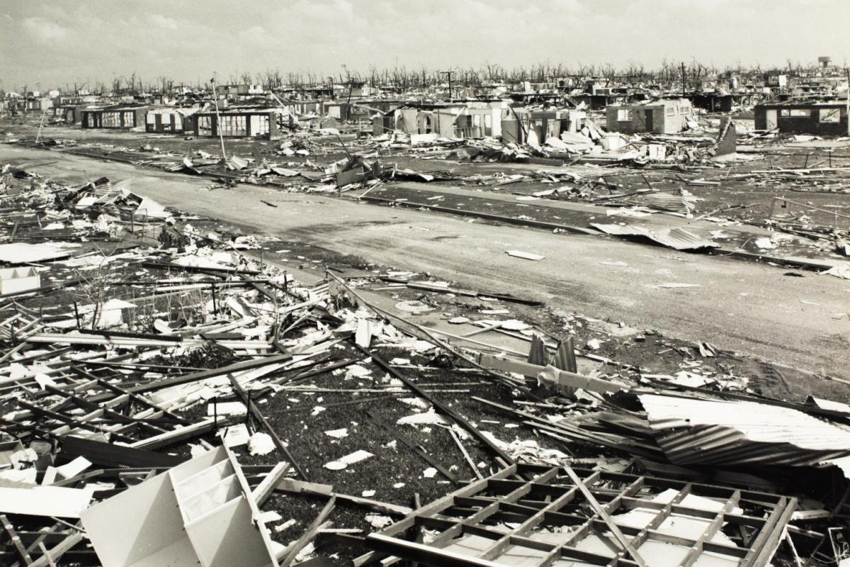
Aftermath: Cyclone Tracy

Slide 5
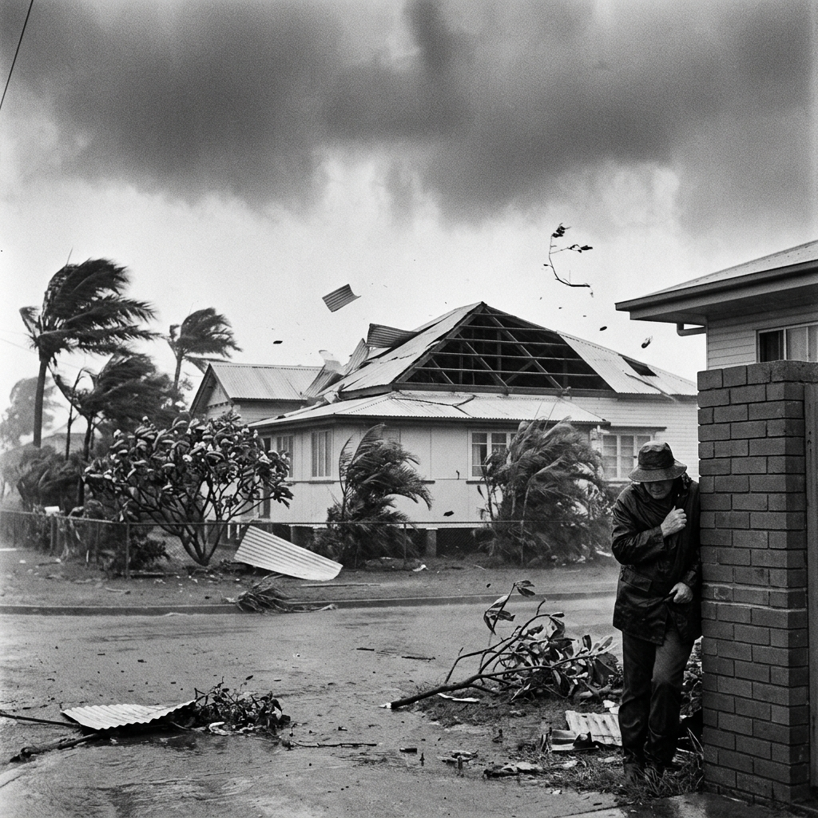
Failure: Cyclone Althea

Slide 6
Labelled vs Annotated
- Labelled: Names only
- Annotated: Names + Explanations of features.

Slide 7
Convection Currents
1. Warm fluid RISES (less dense)
2. Cool fluid SINKS (more dense)
3. Circular movement forms.
4. Drives cyclone formation.

